Slide 1

Remote collaboration
Amreeta Chatterjee, Swetha Jayapathy, Satyajit Kamble,
Seyedehdelyar Tabatabai, Qingxiao Yuan

Slide 2
Research Questions
What kind of challenges are CS students facing while collaborating remotely on research work during COVID?
RQ1: What are the various channels and tools via which CS students facilitate remote collaborative research?
RQ2: How has remote work been affected by remote collaborative meetings?

Slide 3
Hypothesis
1) What are the various channels and tools via which CS students facilitate remote collaborative research?
Hypothesis 1:
Most students use Zoom for collaborative meetings
2) How has remote work been affected by remote collaborative meetings?
Hypothesis 2:
Students feel better about Remote collaborations than in-person collaborations

Slide 4
Unit of Analysis & Data Collected
Unit of Analysis
The meetings itself
The encountered problems
Tools themselves
CS students
Data Collected
Semi-structured Interview regarding meetings
How did you feel about the meeting going as planned?
What channels and tools did you use to collaborate remotely?
Observations from meetings
Misunderstandings / Repetition of explanation
Body language if cameras are on

Slide 5
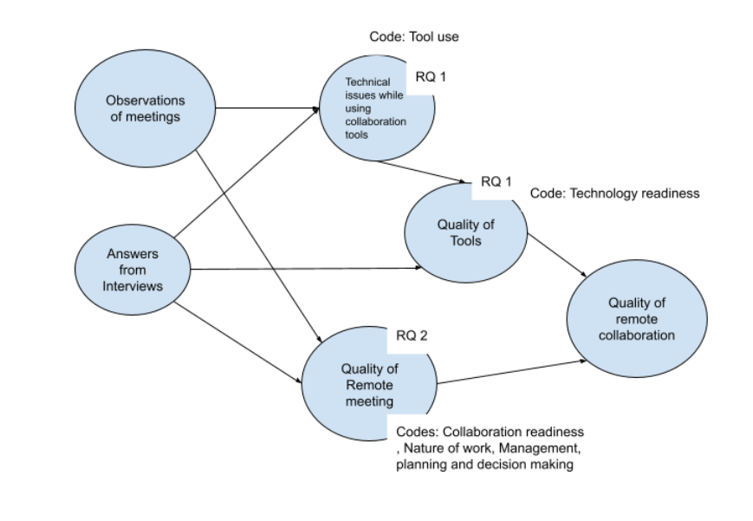
Logic
Notes:
Swetha

Slide 6
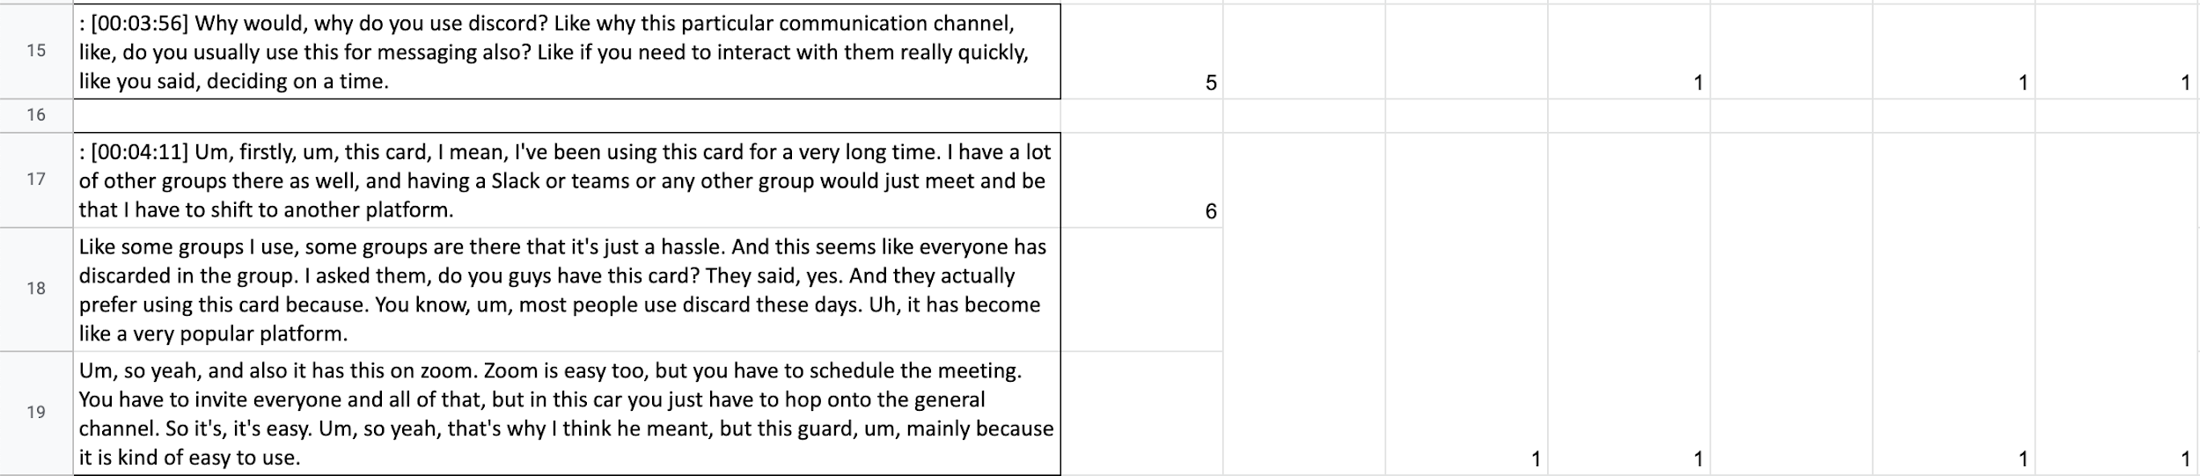
Our Data Segmentation
Our data was generated from several interviews and observations:
The interviews primarily focused on getting rich insights into collaborative meetings
The observations focused on how research collaborations proceeded and how participating members interacted with each other using certain channels of communication.
We moved forward with transcribing the interviews and observations and breaking them down into logical segments which corresponded to conversational turns.

Slide 7
Code selection & Qualitative coding
Our codeset was from the paper - “A theory of remote scientific collaboration” and we selected a certain subset of the codes. This was primarily because many of the codes were not relevant to the specific collaboration aspects we were trying to study.
We picked up the codes and framed rules such that they pointed in the direction towards answering the research questions
2 of us team members were responsible for coding the segmented data:
We first coded a small piece of out dataset (~5%) and discussed our choices and got a better understanding of why each of us individually chose the codes we chose
At every iteration, we calculated the Jaccard index to check the degree to which we agreed upon our choices of the codes.
Around the ~20% mark, we were able to achieve a Jaccard score of ~84% after which we decided to code independently.
There were 6 codes we used which were successful in capturing the essence of each segment quite accurately
Notes:
Olson, JS. 2008. A Theory of Remote Scientific Collaboration.

Slide 8
Coding Rules
Code 1: (Nature of work) Whenever sentences mention about working chemistry and how team members prefer to work or make the work clear and unambiguous
Code 2: (Common Ground) Whenever segments talk about collective progress, mutual knowledge, beliefs, and/or assumptions and team members sharing a common management or working style
Code 3: (Collaboration Readiness) Whenever sentences mention about the data sharing methods - How do they share the documents and Come up with a meeting time
Code 4: (Mgmt, planning, decisions) Whenever team members are talking about effectiveness, roles, responsibilities, timelines. Any member exhibiting strong leadership qualities, Whenever a communication plan is in place.
Code 5: (Technology Readiness) Whenever participants mention the preference of a technology, Collaboration technologies provide the right functionality and are easy to use, Technology readiness also involves reliability. If the technology is unstable (as some research proof-of-concept prototypes can be), people will be unlikely to use it
Code 6: (Tool Use) Whenever participants mention the usage of a tool and/or why they use it

Slide 9
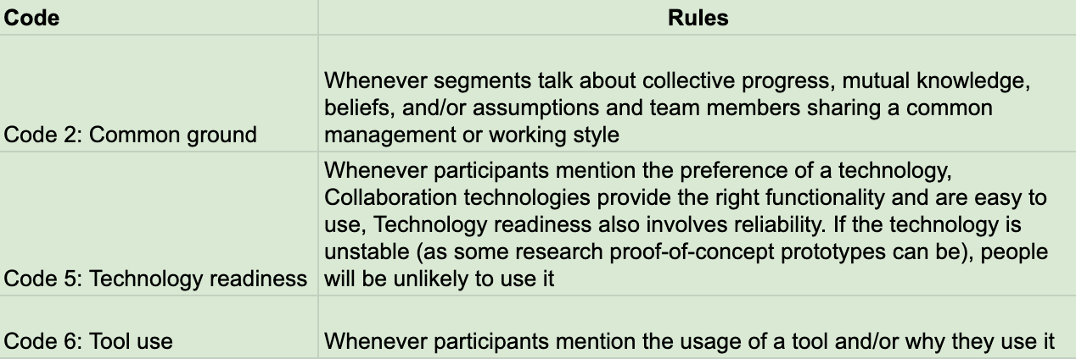
RQ1) What are the various channels and tools via which CS students facilitate remote collaborative research?

Slide 10
RQ1) What are the various channels and tools via which CS students facilitate remote collaborative research?
Answer: Slack, Discord for communication channels, e.g. schedule a meeting.
<Code 2&6, Participant 1, Segment ID 5, “most people use discord these days.. mainly because it is kind of easy to use”>
<”Code 2&5&6, Participant 2, Segment ID 137, "*Why do you use discord?- i've been using discord for a long time..">
<Code 5&6, Participant 1, Segment ID 6, “I have a lot of other groups there as well, and having a Slack or teams or any other group would just meet and be that I have to shift to another platform.”>
<Code 6, Participant 2, Segment ID 46, ”..We usually do Slack or zoom”>

Slide 11
RQ1) What are the various channels and tools via which CS students facilitate remote collaborative research?
Answer: Google Forms, Google Docs, Google Drive, Zoom, Google Sheets, Atlas.ti, Qualtrics, Overleaf for collaboration tools.
<Code 5, Participant 1, Segment ID 8, “but anytime there is a group project, the first think I do is start a Google drive...easier for everyone in the team… I personally like to do as when you're collaborating on something….”>
<Code 2, Code 6, Segment ID 5, “..Zoom is easy too... because it is kind of easy to use”>
<Code 5, Segment ID 99, “The software they use are Atlas.ti ...”>
<Code 2, Code 5&6, Segment ID 9, “.. everyone will be using Qualtrics.”>
<Code 5&6, Segment ID 103, “A shares her screen and opens up the overleaf tool..”>
Notes:
The kind of platform used is also affected by the kind of relationship between..

Slide 12
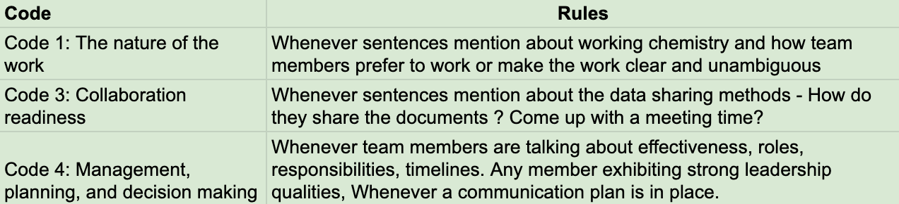
RQ2) How has remote work been affected by remote collaborative meetings?
Notes:
From our codeset, the codes nature of the work, collaboration readiness and management, planning and decision making answer our second research question

Slide 13
RQ2) How has remote work been affected by remote collaborative meetings?
Flexible meeting schedules
No “divide and conquer” strategy in smaller group meetings
Participant 3 [Segment ID: 2]: “..everyone is available at a different time..having one calendar invite every week seemed a little bit, uh, problematic...if my team members were non-collaborative, then, uh, meetings can be the best way to bring everyone on the same page.”
Participant 3 [Segment ID: 4]: “.. we all look on the same thing. We don't divide and conquer at least. So what we do is we and prepare before meeting.”
Notes:
Both positive and negative ways in which work has changed while remotely collaborating and how students have adapted to this way of working. E.g., Student researchers don’t have a fixed meeting schedule every week because everyone’s available at a different time and prefer flexible hours.
In remote collaboration, team members also mentioned that they do not “divide and conquer”. They work on everything together in a meeting with one person sharing their screen and everyone else giving their inputs.

Slide 14
RQ2) How has remote work been affected by remote collaborative meetings?
Increased contribution of members due to collaborative features of tools
Video are not on for longer meetings
Participant 3 [Segment ID: 29]: “...if someone has an idea and you are continuously talking on a zoom call and the other person does not have an opportunity to pitch it, they will leave a text message right there, multiple ways of presentation right now.”
Participant 3 [Segment ID: 25]: “.. I don't want to see someone's face for six to seven hours...it would be nice. But at the same time, when you're working on a Google doc together, you're looking at the Google doc...You're not talking to someone face to face for like six hours or five hours.”
Notes:
Contribution from all members might have increased because of the collaboration features of the tools being used.. If everyone has access to the internet, everyone has equal resources while collaborating online. Whereas in offline, our participant mentioned that its usually one person drawing on the whiteboard.
“And you have easy access to materials. You had the same Google doc that you're working on. It's not. And then people, so one person has a board that it wasn't this not habit. It's not like that everyone has equal resources. It's, it's kind of inclusive. You know, you, you can all pitch”
Even though participants said it is nice of have the camera on when talking to someone, they mentioned that they don’t have their cameras on when they are working for six to seven hours, because even in real life meetings, you don’t look at someone for that long.. You look at the google doc. Whereas another person said they have their cameras on and use gestures to convey that they have something to say.

Slide 15
RQ2) How has remote work been affected by remote collaborative meetings?
Large group meetings and non-collaborative team members
Participant 3 [Segment ID: 31: “...one of the team members kind of dropped out...kind of non-responsive for the, from week two because he only attended one meeting of ours..most teams had four members and we had three members...I and my teammates had to do a lot of things..I saw people being online and not responding ”
Notes:
Management and decision-making play roles when there are large group meetings (Around 10 members) and when team members are not collaborative. For example, a team leaders way of “management” would be to schedule a fixed meeting time each week instead of having flexible meeting times.
In our observation notes, we also found details where our group observed in a meeting that a project lead was a good manager because they had things such as software tools opened and ready to get started for the meeting.
Therefore, as we hypothesized earlier, according to our participants, they feel better Remote collaborations is much better than in-person collaborations and more inclusive. Delyar will continue with the explanation of the co-occurence between our codes.

Slide 16
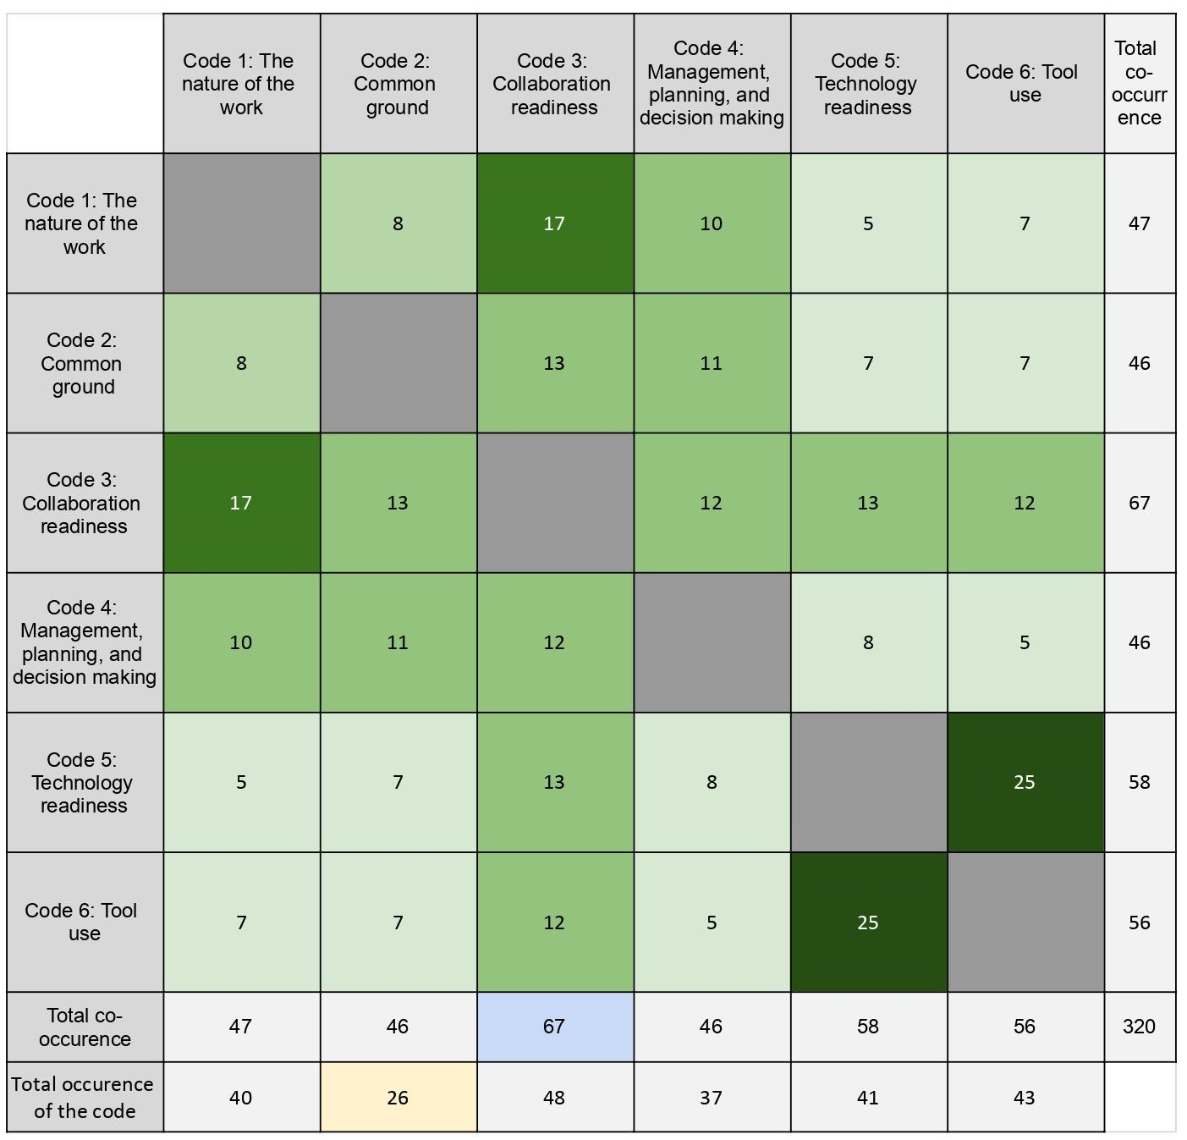
Results - Co-occurrence Matrix
Collaboration Readiness plays the most significant role in all aspects of a remote collaboration.
Participants think about technology and tools completely different from thinking about people except for Collaboration Readiness.
Collaboration technologies providing the right functionality and are easy to use determine the tool usage in the remote collaborations.
Notes:
Delyar

Slide 17
Triangulation
Data Source Triangulation:
We collected data from different collaborative meetings :
Observations from collaborative meetings (Course work, Research work)
Semi-structured interviews
Same results from different sources
Participant Validation:
Sending out surveys regarding our results to the participants
Notes:
Sweetha

Slide 18
Reference page
Olson, JS. 2008. A Theory of Remote Scientific Collaboration.

Slide 19
Feedback
Any questions or suggestions?

